Slide 1


Data Visualization: Principles and Applications in R, Tableau, and Python
Silas Bergen
Todd Iverson
2019 Symposium on Statistics and Data Science
Bellevue, WA

Slide 2
SDSS data viz sessions to note
Thursday 10:30-12: Visual Storytelling
Alberto Cairo, U Miami
Matthew Brehmer, Microsoft
Amber Thomas, The Pudding
Thursday 1:30-3: Data viz in Python
Stephen Elson, Quantia Analytics
Dominik Moritz, U Washington
Kanit “Ham” Wongsuphawat, Apple
Friday 1:30-3: Data viz education
Michael Freeman, U Washington
Jerzy Wieczorek, Colby College
Robert Kosara, Tableau
Friday 3:40-5:15: Data viz at the IHME
Ryan Shackleton, IHME
Evan Laurie, IHME
Marlena Bannick, IHME
Friday 5:20-6:25: GoG 20th Anniversary
Lee Wilkinson, H2O.ai
Anushka Anand, Tableau
Jeffrey Heer, U Washington
Bryan Van de Ven, Microsoft
Saturday 10-11:30: GoG From Theory to Applications
Steven Drucker, Microsoft
Claus Wilke, U Texas Austin
Anushka Anand, Tableau
See entire data viz track: https://bit.ly/2QeAWFe

Slide 3
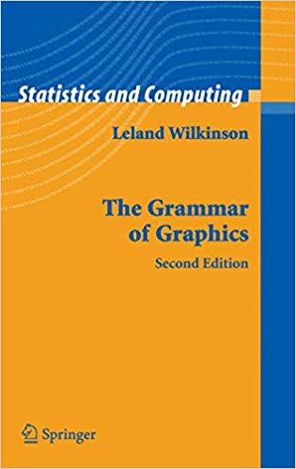
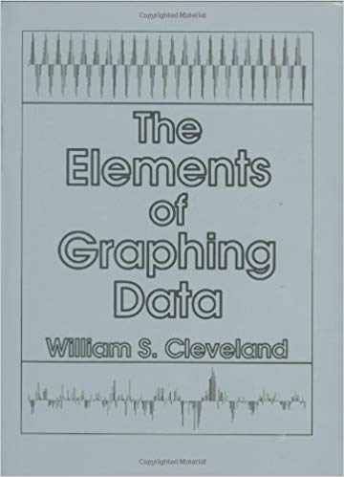
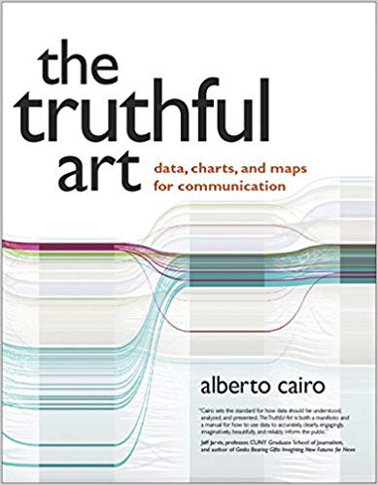
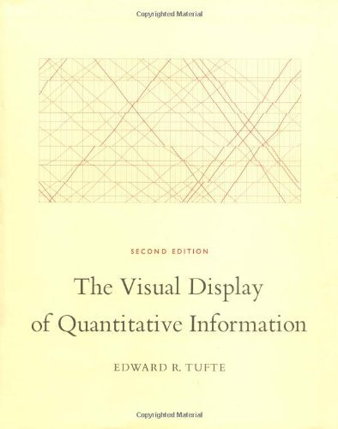
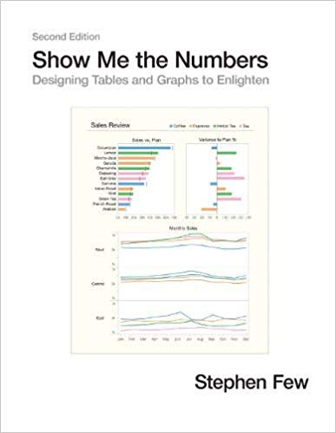
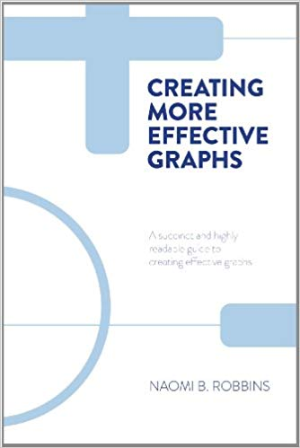
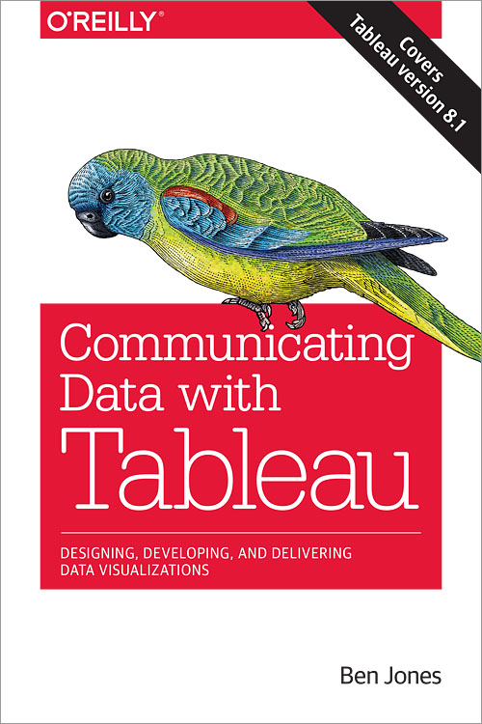

Slide 4
In the visualizations that follow:
What information can you extract?
How are you extracting this information?

Slide 5
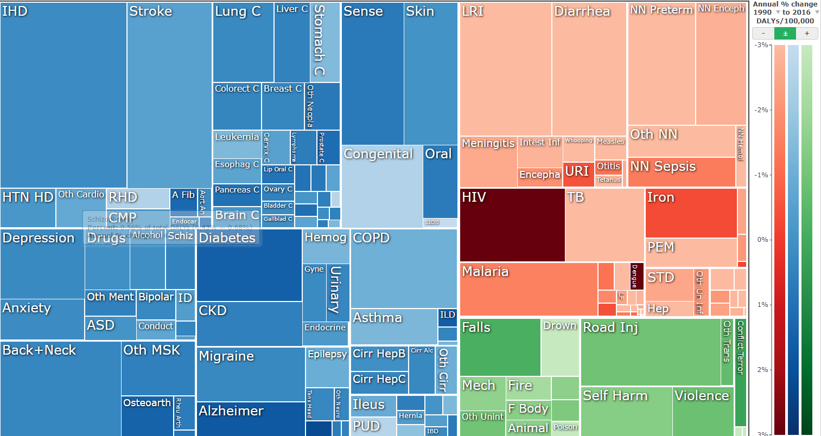
IHME disability adjusted life years (DALYs) visualization
https://vizhub.healthdata.org/gbd-compare/

Slide 6
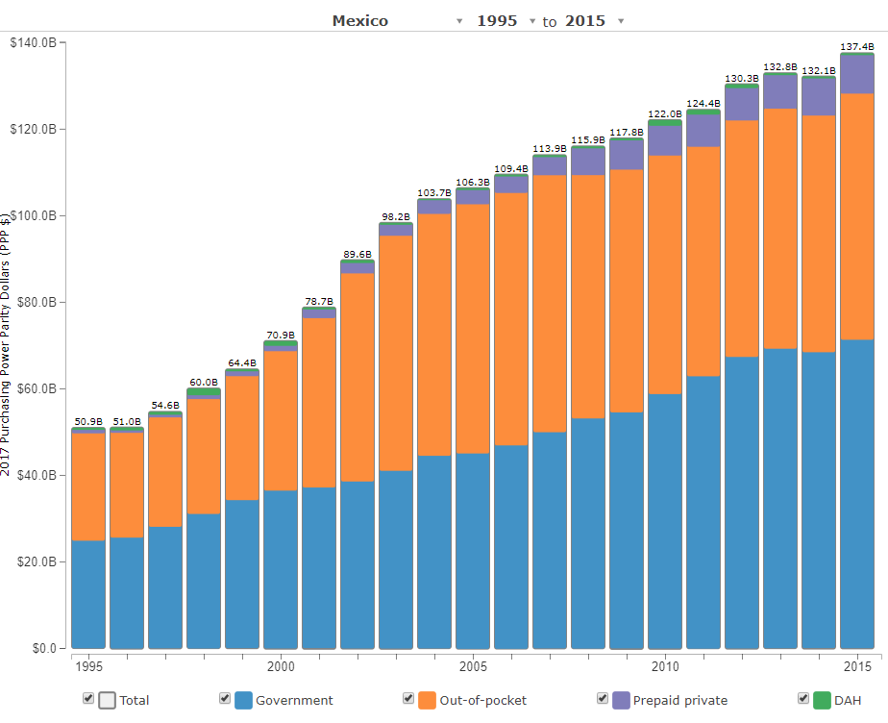
IHME health care spending visualization
(DAH = Development Assistance for Health)
http://ihmeuw.org/4iuu

Slide 7
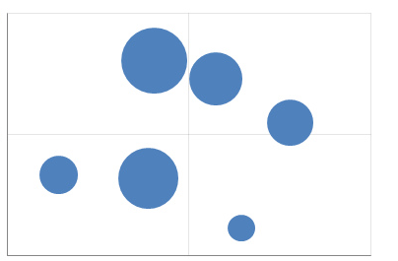
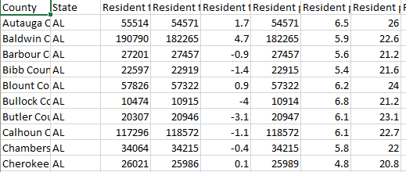
What is a data visualization?
A set of visual geometries whose aesthetics are mapped from data
Many major visualization software (Tableau, ggplot in R, Altair in Python, graph builder in JMP) are based on this grammar
Aesthetic
Data
Geom/Mark

Slide 8
What is a data visualization?
Data is encoded in the visual aesthetics of geometries/marks
Many major visualization software (Tableau, ggplot in R, Altair in Python, graph builder in JMP) are based on this grammar
Encode/Map to Aesthetics
Data
Geom/Mark

Slide 9
Geometry
A geometry is a visual entity in space.
Some common geometries encountered in data visualizations:
Point
Line
Bar

Slide 10
Aesthetic
An aesthetic is a visual attribute of a geometry
Common aesthetics:
Position on horizontal (X)
Position on vertical (Y)
Shape
Size
Color
Hue
Saturation (“intensity”)
Value (“brightness”)
Text
Not all aesthetics are available for every geometry

Slide 11
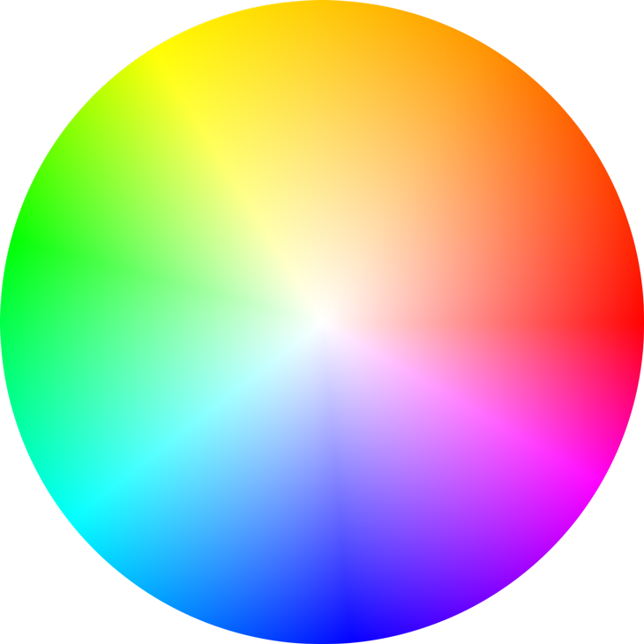
HUE
SATURATION
https://color.adobe.com/build2.0.0-buildNo/resource/img/kuler/color_wheel_730.png

Slide 12
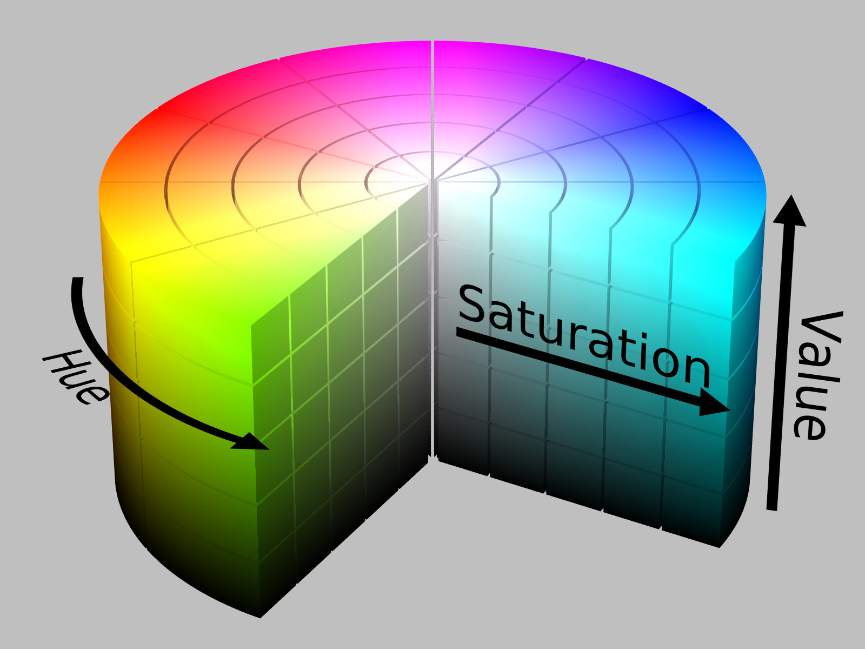
https://upload.wikimedia.org/wikipedia/commons/0/0d/HSV_color_solid_cylinder_alpha_lowgamma.png

Slide 13
Aesthetic attributes of a point geometry
What distinguishes one point from another point?
X, Y
Shape
Size
Hue
Saturation
Value
Text
Point B
Point A

Slide 14
Aesthetic attributes of a point geometry
What distinguishes one point from another point?
Position
Shape
Size
Y
X
Color
Value
Text
Hue
Point B
Saturation
Point A

Slide 15
Aesthetic attributes of a line geometry
What distinguishes one line from another line?
X, Y
Shape
Size
Hue
Saturation
Value

Slide 16
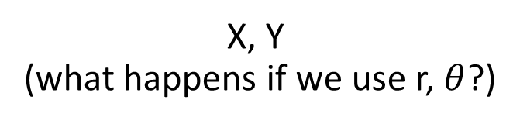
Aesthetic attributes of a bar geometry
What distinguishes one bar from another bar?
X, Y
(what happens if we use r, $θ$?)
Shape
Size
NA
(a bar is a bar!)
Hue
Saturation
Value

Slide 17
Data
To visualize, must have data in row-by-column format where:
Rows represent cases: at most one geometry per case (assuming no aggregation)
Columns represent variables: to be mapped to aesthetic attributes

Slide 18
Specifying a data visualization
Differences in geometry aesthetics map to differences in data variables
Available mappings depend on whether data variable is continuous (height) or discrete (race)

Slide 19


Specifying a data visualization
The following caveats apply:
An aesthetic attribute can be mapped back to at most one variable
A variable can be mapped to more than one aesthetic
Not all mappings make sense
Height
Size
Age
Size
Sex
Hue
Height
Shape

Slide 20
Modifiers
Ties: when two cases yield overlapping geometries under a given mapping
Some common modifiers:
Jitter: Stack: Dodge:
+
=

Slide 21
Specify the mappings!
Revisit the three visualizations we encountered earlier. Identify:
The data cases (assuming one geometry per case);
The geometries;
The aesthetic attributes that are varied;
The variables that control the differences in aesthetic attributes (bonus: are they continuous or discrete?)
Modifiers (if any)

Slide 22
IHME GBD visualization
https://vizhub.healthdata.org/gbd-compare/
Notes:
Quickly; add “key” slides

Slide 23
IHME health care spending visualization
(DAH = Development Assistance for Health)
http://ihmeuw.org/4iuu
Notes:
Quickly; add “key” slides

Slide 24
Visual perception
How we compare quantities

Slide 25
Recall the following aesthetic attributes:
Position on horizontal (X)
Position on vertical (Y)
Shape
Size
Color
Hue
Saturation (“intensity”)
Value (“brightness”)
Cleveland & McGill created a ranking of these when mapping a geometry to a quantitative variable

Slide 26
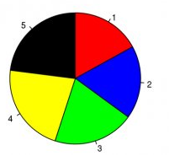
Hypothetical polling data on 5 candidates.
Rank the candidates’ vote shares.
Walter Hickey at Business Insider
Specification
Geometry: “pie wedge” (a bar in polar coordinates)
Aesthetic mappings:
Candidate (discrete) → hue & text
share of vote (continuous) → size, specifically angle

Slide 27
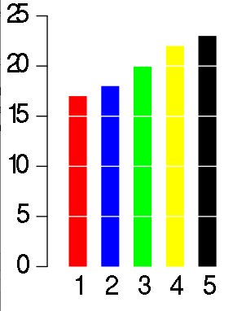
Same data, different visualization
Rank the candidates’ vote shares.
Walter Hickey at Business Insider
Specification
Geometry: bar
Aesthetic mappings:
candidate → hue & X
share of vote → Y

Slide 28
Elementary perceptual tasks
a set of tasks that are carried out when people extract quantitative information from graphs
Cleveland and McGill. Graphical Perception: Theory, Experimentation, and Application to the Development of Graphical Methods. JASA, 1984

Slide 29
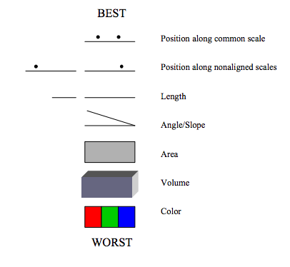
Cleveland’s and McGill’s hierarchy of elementary perceptual tasks
Image source: Wilkinson, Presentation Graphics

Slide 30
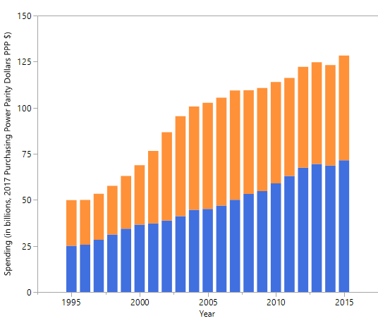
Mexico’s health spending (Government and Out-of-pocket only)
Geometry: Bar
Year → X
Spending → Y
Source → Hue
Modifier: Stack
Geometry: Bar
Year → X
Spending → Y
Source → Hue
Modifier: Dodge
Geometry: Point
Year → X
Spending → Y
Source → Hue, Shape
Modifier: None

Slide 31
Gestalt principles
How we perceive groups

Slide 32
gestalt = form or pattern
Gestalt philosophy: the whole is greater than the sum of the parts
Gestalt principles: predictable ways by which we organize sensory information
Developed by Max Wertheimer & followers; early 20th century

Slide 33
Find the fives
6
3
1
2
1
9
5
3
2
8
5
5
7
5
5
4
9
5
5
4
3
6
5
3
9
4
3
5
8
2
2
1
5
7
4
3
1
5
5
7
6
5
9
8
4
2
4

Slide 34
Find the fives
6
3
1
2
1
9
5
3
2
8
5
5
7
5
5
4
9
5
5
4
3
6
5
3
9
4
3
5
8
2
2
1
5
7
4
3
1
5
5
7
6
5
9
8
4
2
4
Inspired by Fig 6.2, The Functional Art by Alberto Cairo

Slide 35
Similarity
rows or columns?

Slide 36
Similarity
rows or columns?

Slide 37
Proximity
rows or columns?

Slide 38
Connection
rows or columns?

Slide 39
Enclosure
rows or columns?

Slide 40
Some principles are stronger than others

Slide 41
rows or columns?

Slide 42
rows or columns?

Slide 43
What are the groups?
Within group: rows or columns?
Notes:
Left/right
Within left: columns; within right: rows

Slide 44
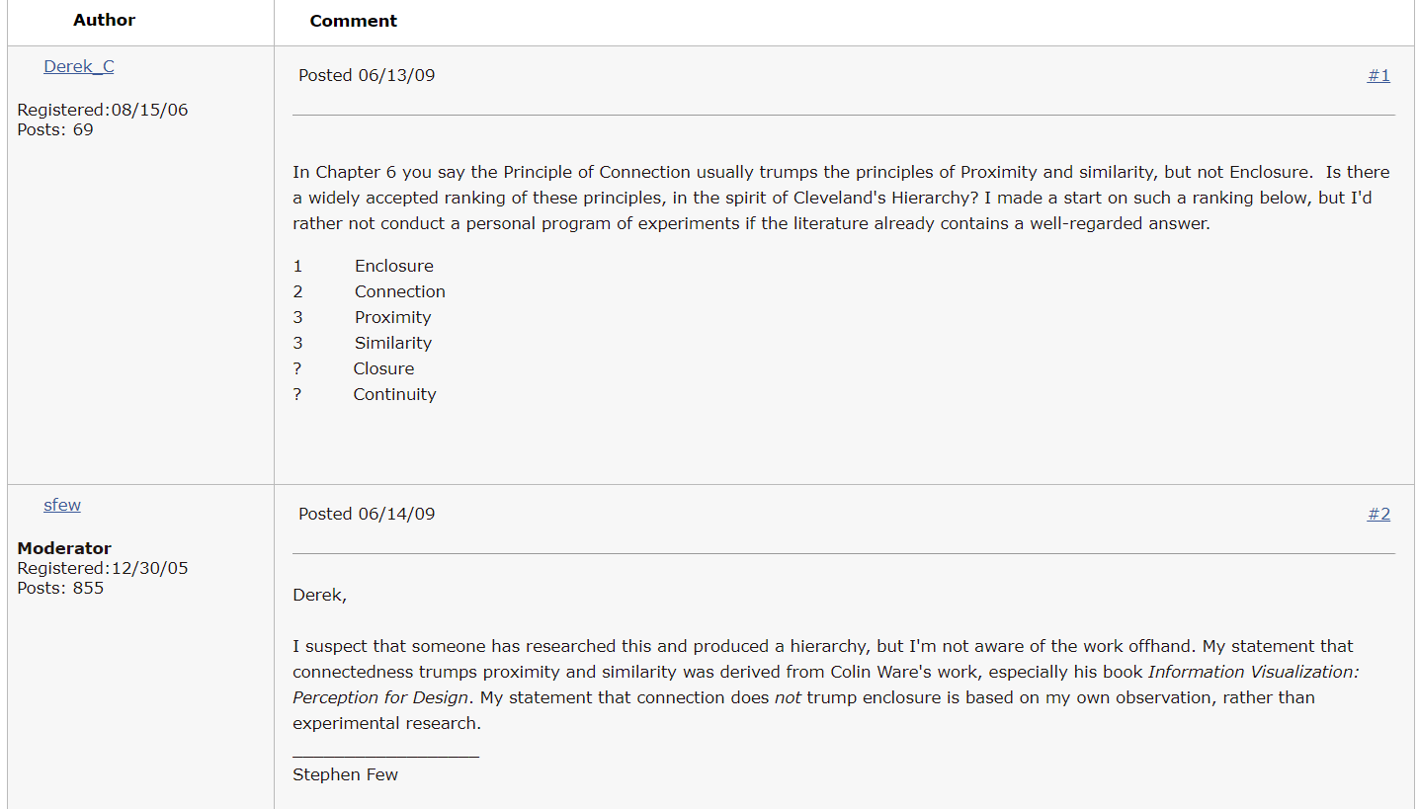
http://sfew.websitetoolbox.com/post/ranking-the-gestalt-principles-3524646 (now unavailable; 5/8/19)

Slide 45
color usually trumps shape when incorporating similarity

Slide 46
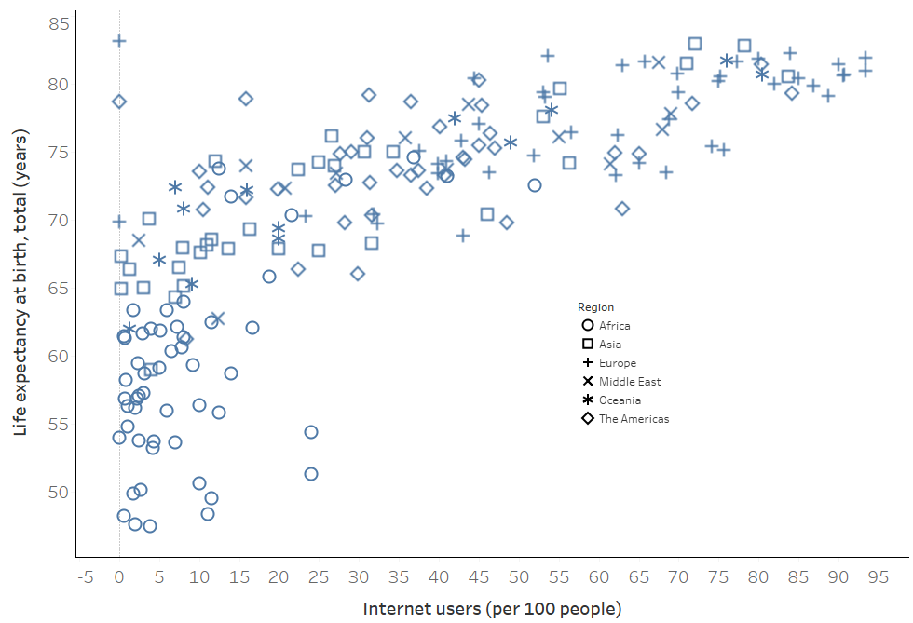
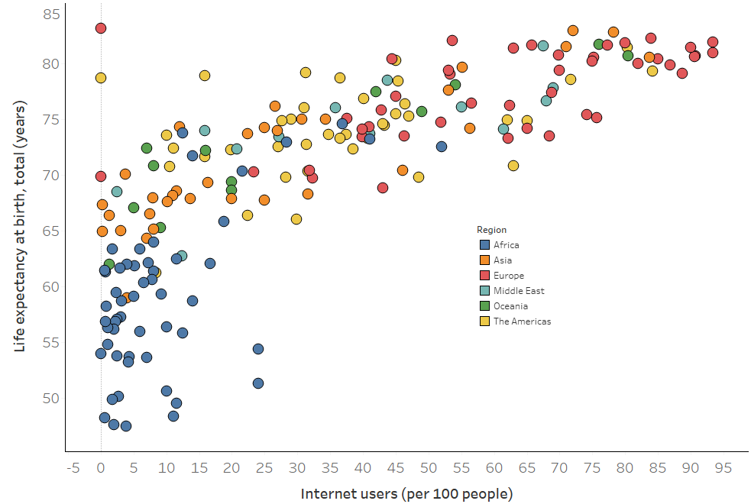
Data source: World Bank, 2010 indicators

Slide 47
but you can double up

Slide 48
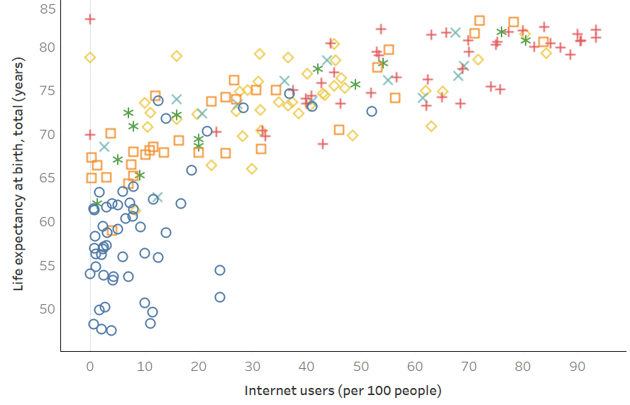

Slide 49
Implications for practice
Know how we compare quantities
Know how we perceive groups
Employ these principles to facilitate the most important comparisons
“The most important comparisons” depend on your message

Slide 50
> fake_data
Factor1 Factor2 Response
1 A I 15
2 A II 5
3 A III 5
4 B I 10
5 B II 15
6 B III 15
7 C I 5
8 C II 10
9 C III 10

Slide 51
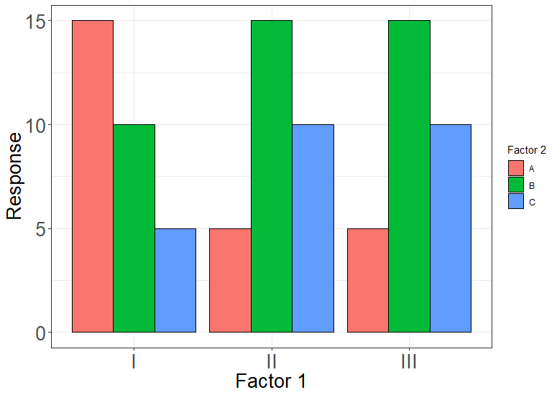
Geom: bar
Position_X: Factor 1
Color: Factor 2
Position_Y: Response
Notes:
775 x 550; proximity

Slide 52
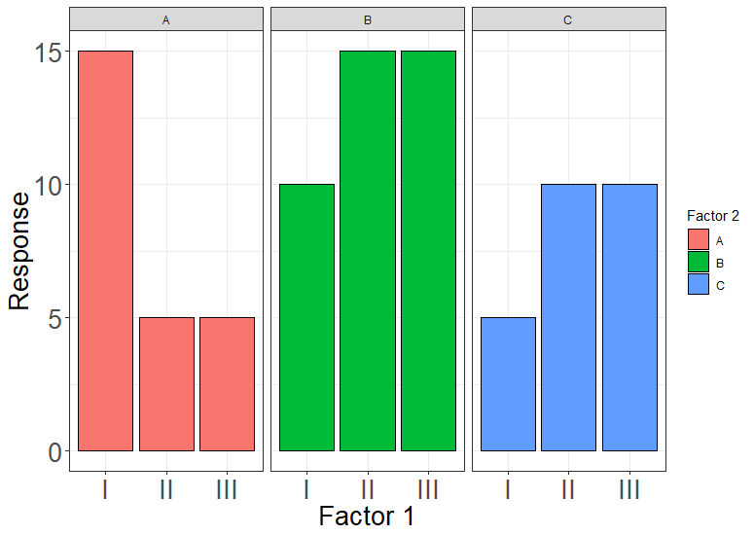
Geom: bar
Position_X: Factor 1
Color: Factor 2
Position_Y: Response
FACET: Factor 2
Notes:
775 x 550; proximity + enclosure

Slide 53
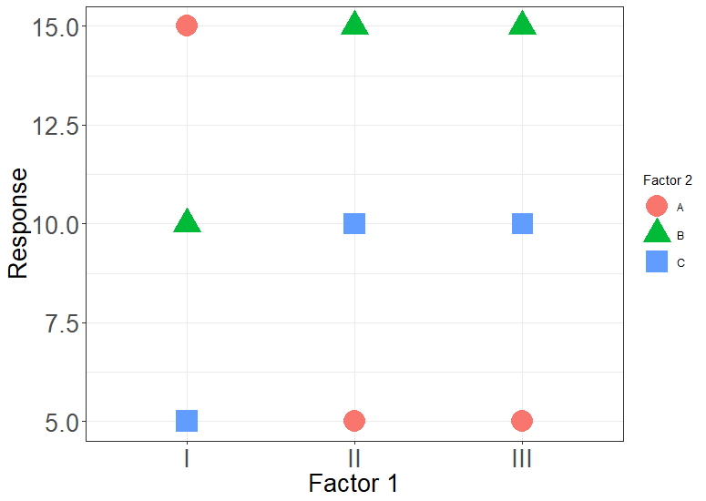
Geom: point
Position_X: Factor 1
Color: Factor 2
Shape: Factor 2
Position_Y: Response
Notes:
What am I supposed to look at? Similarity is too weak

Slide 54
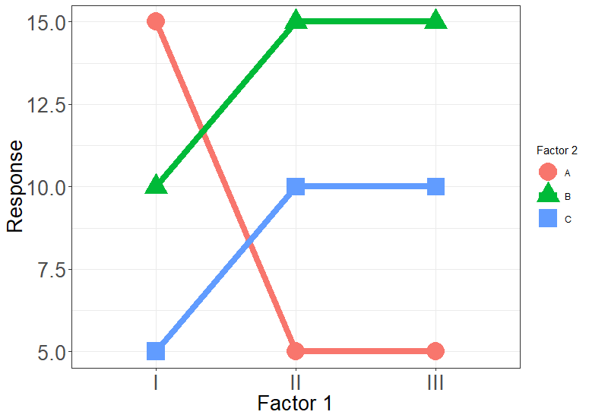
Geom: point
Position_X: Factor 1
Color: Factor 2
Shape: Factor 2
Position_Y: Response
Geom: line
Position_X: Factor 1
Color: Factor 2
Group: Factor 2
Position_Y: Response
Notes:
Adding connection helps

Slide 55
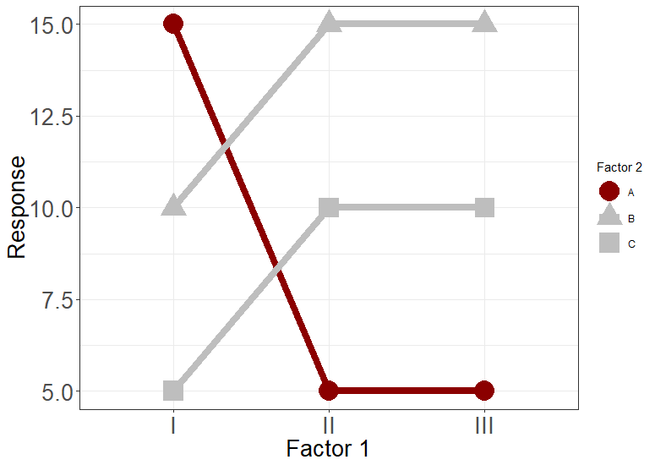
Geom: point
Position_X: Factor 1
Color: Is_neg
Shape: Factor 2
Position_Y: Response
Geom: line
Position_X: Factor 1
Color: Is_neg
Group: Factor 2
Position_Y: Response
Notes:
Similarity + connection

Slide 56
Geom: point
Position_X: Factor 1
Color: Is_neg
Shape: Factor 2
Position_Y: Response
Geom: line
Position_X: Factor 1
Color: Is_neg
Group: Factor 2
Position_Y: Response
Notes:
Enclosure + Similarity + connection

Slide 57
Design

Slide 58

Alberto Cairo
http://www.thefunctionalart.com/

Slide 59
The five qualities of great visualizations
Truthful
Functional
Beautiful
Insightful
Enlightening
Alberto Cairo, The Truthful Art, Ch 2.

Slide 60
1. Truthful
Is the visualization based on thorough and honest research?

Slide 61
2. Functional
Does the visualization facilitate meaningful comparisons?

Slide 62
3. Beautiful
Is it attractive, intriguing, and aesthetically pleasing?

Slide 63
4. Insightful
Does the visualization elicit an “a-ha”, a “wow”, an “I see”?

Slide 64
5. Enlightening
Does the visualization cast light over relevant issues? Will it “change minds”?

Slide 65
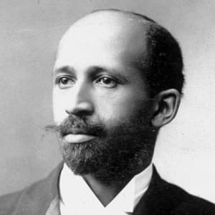
Exposition Universelle Paris World Fair 1900
W.E.B. Du Bois
Sociologist, Atlanta University

Slide 66
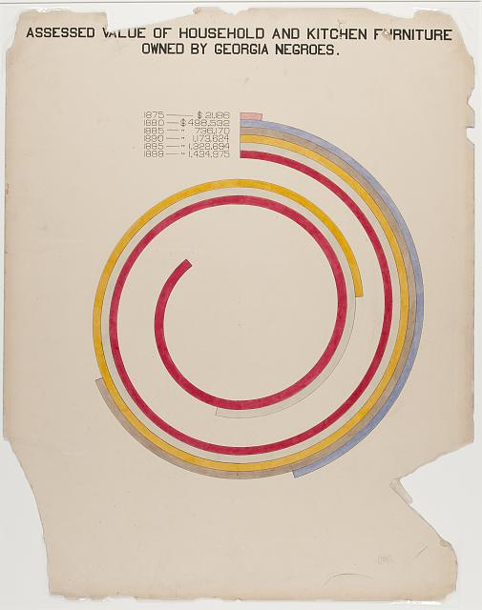
Image Source: https://www.loc.gov/pictures/resource/ppmsca.33887/?co=anedub
Notes:
Beautiful: Pre-empts the Avant Garde European art movement

Slide 67
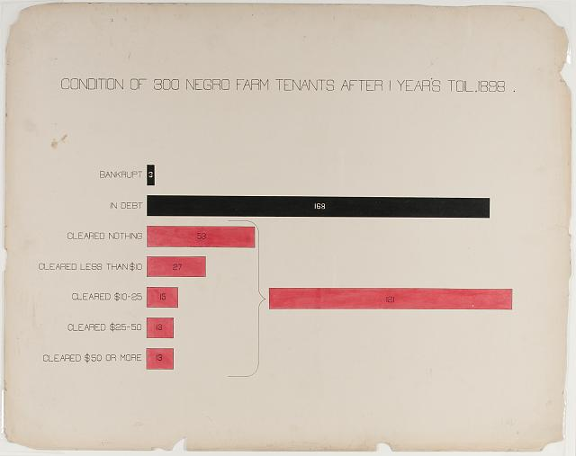
Image Source: https://www.loc.gov/pictures/resource/ppmsca.33892/?co=anedub
Notes:
Insightful: Power of annotation

Slide 68
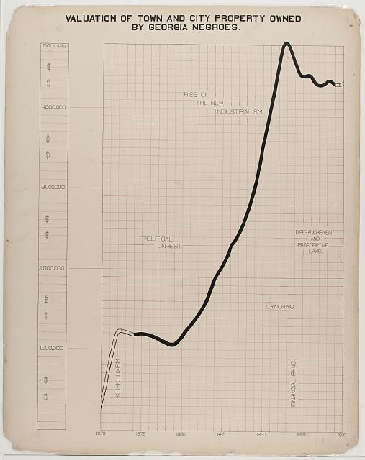
Image Source: https://www.loc.gov/pictures/resource/ppmsca.33883/?co=anedub
Notes:
Insightful: Power of annotation

Slide 69
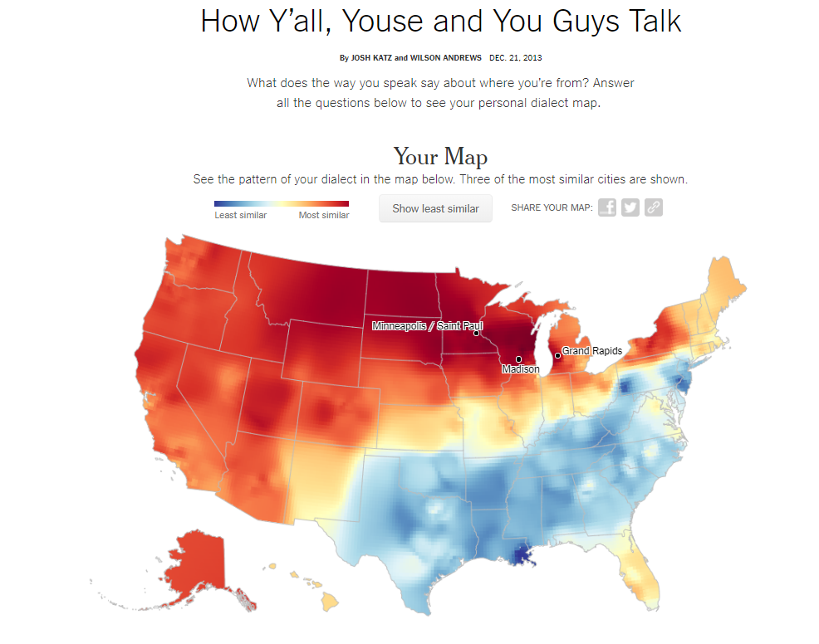
https://www.nytimes.com/interactive/2014/upshot/dialect-quiz-map.html

Slide 70
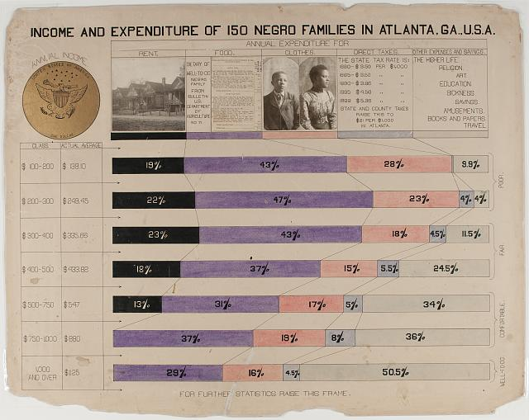
Image Source: https://www.loc.gov/pictures/resource/ppmsca.33893/?co=anedub
Notes:
When a legend is more than just a legend

Slide 71
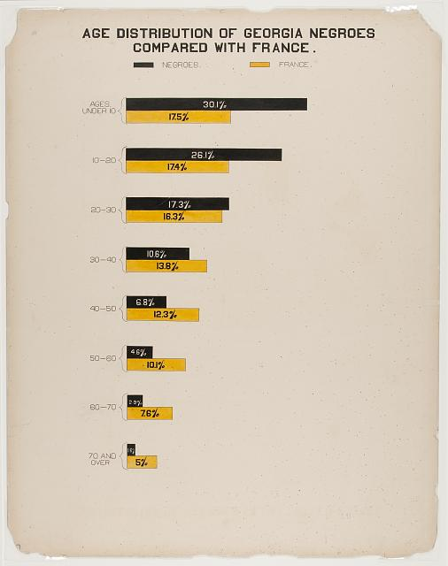
Image Source: https://www.loc.gov/pictures/resource/ppmsca.33871/?co=anedub
Notes:
The “Me” factor

Slide 72
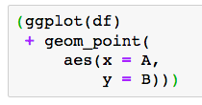
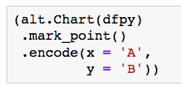
ggplot2
altair
data
geometry
aesthetic mapping

